Slide 1

SuperFit
Apparel Shopping made Easy...

Slide 2
Our Team...
Group ID: 3A72021
10703- Sagar Abhyankar
10705- Om Gund
10708- Samir Hendre
10710- Mrunal Golivadekar
10713- Mugdha Malpe

Slide 3
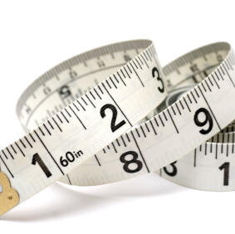
Problem statement
While doing online shopping for clothes and shoes we have to waste time measuring out our dress sizes manually and then selecting the right option according to the units.

Slide 4

Objective...
The objective or aim of this project is to create a user-friendly website which makes online apparel shopping simple and less time consuming.
"Necessity is the mother of all invention." This famous proverb said by Plato is the most relevant phrase in this new world. The pandemic has brought along with it many problems, some major and some minor.
However, this state of uncertainty and chaos has given a massive impetus to innovation and problem solving.

Slide 5
By means of this project, we intend to make online apparel shopping easy and less time consuming. This problem is not exactly the spawn of this pandemic, but this phase has surely increased the amplitude of it.
As more and more businesses move to the online space, it has become necessary for the consumers to keep up. Customers, especially the older demographic are skeptical about online apparel shopping. According to consensus, it is because of the ambiguity is clothing sizes and lack of a universal sizing system.
Our project aims to find an elegant solution to this problem. This project employs modern technologies like camera scanning to provide the exact clothing size to the customer.

Slide 6
Resources
The project has a backend base of the Django framework which is a web development library in Python.
OpenCV documentation: github.com/opencv/opencv
Bootstrap documentation: Bootstrap · The most popular HTML, CSS, and JS library in the world. (getbootstrap.com)
Django documentation:Django documentation | Django documentation | Django (djangoproject.com)
For the scanning and size return feature we have made use of OpenCV, which is a computer vision library in Python.
For the front-end part we have used HTML, CSS and JavaScript. We have also made use of Bootstrap which is the most popular front-end library in the world.

Slide 7

Requirements...
The requirements of this project are not that high. Any web browser, preferably Google Chrome is required to access the website. The latest version of the browser is preferred.
Another requirement is a good quality webcam which will allow us to take a clear image.

Slide 8
Features
Just stand in front of the camera and rotate once , so that your body is scanned and the app takes care of the metrics .
Once scanned , the app automatically selects the perfect fitting size(if available) and allows you to place the order directly.
If you already have done scanning previously you don’t need to scan twice and can click on your saved profile so that the results are directly shown according to your dimensions once applied.
Customers no longer have to manually read through the graph provided for each country like UK,India,US , hence user friendly and less time consuming

Slide 9
Instructions...
Step 1
1
First visit the website, create an account and set the profile picture.
While taking this image, open the pattern app on your phone and hold it in your hand which will serve as a reference image.
Step 4
4
Further, you will be directed to a redirection page where you will have links to a page of Amazon Fashion which will have clothes of your exact size.
Step 3
3
Step 2
2
After that, go to the scanning section where you will have two options. One will be to upload the image directly from the device and the other will be to take image directly from the webcam.

Slide 10

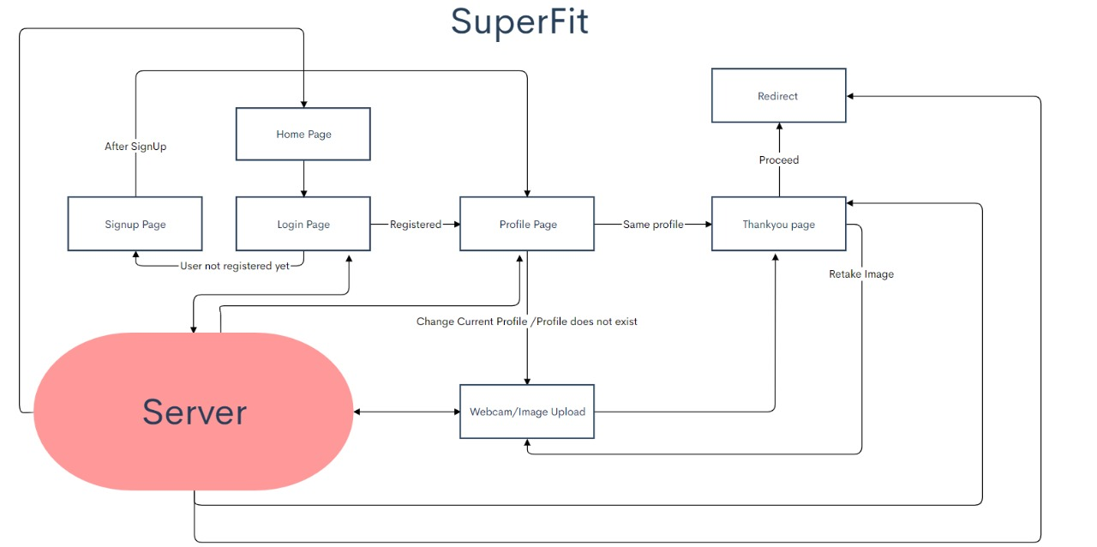

Slide 11
PLAN
Database check
Getting the size
Redirecting
Overall working
Image with pattern
sqllite
Open cv
Website

Slide 12
Scanning
The person is first scanned
DB check
Creating profile , checking availability
Redirecting
Creation of a hyperlink and redirecting the user to that address

Slide 13
Work Division
Mugdha Malpe: Frontend design.
Mrunal Golivadekar: Frontend design.
Om Gund: AI and ML part.
Sagar Abhyankar: Backend, AI/ML part.
Samir Hendre: Backend.
This is the on-paper division of work for the project. Each person has contributed in some way or the other to the other parts of the Website.

Slide 14
Future Scope...
The project has a lot of future scope. In the next decade or so most businesses and services will move to the digital space. This project can assist in this transition.
An update that can be made to this project is to eliminate the pattern(Reference image) from the image scanning process. This takes up two devices and makes it a bit tedious.
Currently, we just redirect to the pages of online shopping websites. An update that can be made to this feature is to create a dedicated e-commerce website of our own which will make the process even more streamlined.

Slide 15
Acknowledgement
We would like to thank Professor M.D Bandkar sir for guiding us throughout the duration of this PBL course and inspiring us to think of new and innovative ideas to solve real world problems.
We would also like to thank the Director, Dr. P.T. Kulkarni sir and the Principal, Dr. R. Sreemathy madam and FE HOD, Professor E.M. Reddy sir for giving us this valuable opportunity. .

